Slide 1

Note: The data and information in this document is reflective of a hypothetical situation and client. This document is to be used for KPMG Virtual Internship purposes only.
Sprocket Central Pty Ltd
Data analytics approach
[Division Name] - [Engagement Manager], [Senior Consultant], [Junior Consultant]

Slide 2
Note: The data and information in this document is reflective of a hypothetical situation and client. This document is to be used for KPMG Virtual Internship purposes only.
Agenda
Introduction
Data Exploration
Model Development
Interpretation

Slide 3
Note: The data and information in this document is reflective of a hypothetical situation and client. This document is to be used for KPMG Virtual Internship purposes only.
Introduction
Analyzing Important Features of the Customer Data
Age distribution
Bike purchases within the last 3 years
Job Industry
Cars owned by state

Slide 4
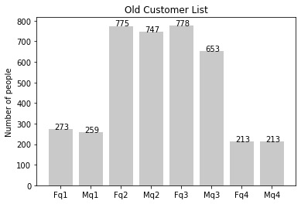
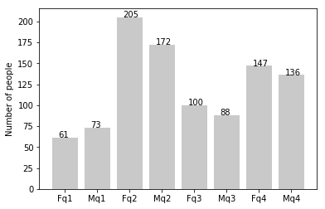
Note: The data and information in this document is reflective of a hypothetical situation and client. This document is to be used for KPMG Virtual Internship purposes only.
Data Exploration
Age Distribution: Significant drop off between 48 and 60 years of age
Old Customer List
New Customer List – Mostly 25 to 48 years old

Slide 5
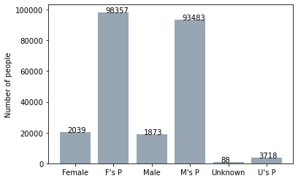
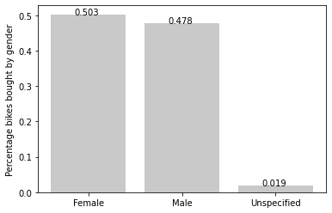
Note: The data and information in this document is reflective of a hypothetical situation and client. This document is to be used for KPMG Virtual Internship purposes only.
Model Development
Within the last 3 years, customers that identify as Female contribute the most purchases at 50.3% of the total
F is Female as M is Male while U/Unknown is Unspecified
Bike Purchase Count
Reorganized Gender Percentage

Slide 6
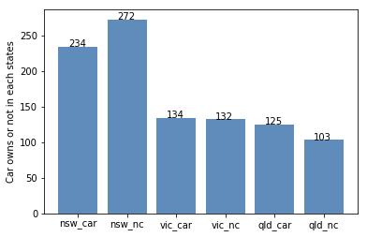
Note: The data and information in this document is reflective of a hypothetical situation and client. This document is to be used for KPMG Virtual Internship purposes only.
Interpretation
New South Wales has the most customers who do not own a car
Number of cars owned/not owned

Slide 7
Note: The data and information in this document is reflective of a hypothetical situation and client. This document is to be used for KPMG Virtual Internship purposes only.
Appendix

Slide 8
Note: The data and information in this document is reflective of a hypothetical situation and client. This document is to be used for KPMG Virtual Internship purposes only.
Appendix
- Miniconda: All diagrams were made from provided datasets on a Jupyter notebook environment through Python’s Matplotlib, Pandas and Numpy libraries

